Slide 1

Best time to post in Social Networks
Created by: Rohit saxena

Slide 2
Objectives
Here, we have two Datasets.
First one is named as “Post Summary”. This contains details about various kinds of messages about different organisations such as flipkart, myntra, Bengaluru traffic police, kokilaben hospital etc. And along with that, we have no. of likes which each of those posts got on facebook.
The second dataset is “Post comments”. It has data about the comments which different posts received.
Both the datasets have one column in common i.e. ‘pid’ which resembles to the unique post id’s given to all the posts in different datasets
To analyse people posting about traffic in different cities such as Bengaluru, Kolkata and Hyderabad
To observe that posts about which categories gets most no. of likes on facebook
Have a word cloud depicting different key words which comes up during a day on facebook

Slide 3
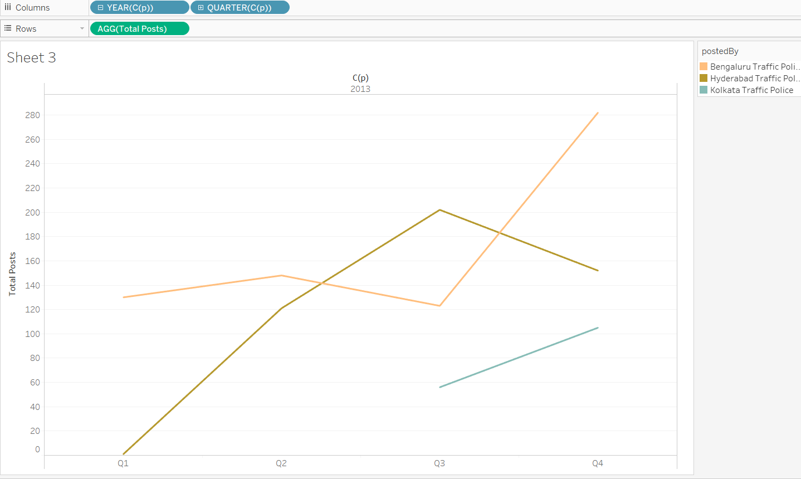
Analysis of traffic pages
From the dataset, I have plotted a graph (on the right-hand side of the page) which shows us about people posting about traffic of three different metropolitan cities of India.
From this we can clearly see that people are suffering from traffic more in cities of Bengaluru and Hyderabad as compared to Kolkata especially in the peak hours in morning and evening which can be quoted as the “best time to post in social networks”.
As the new report came few days back stating Bengaluru is 2nd most traffic affected city in the entire globe and 1st when it comes to traffic congestion, this report proves that quite conveniently.

Slide 4
Average number of likes per post for each category
Here, we tried to find out the average no. of likes which each post gets with respect to different categories. As we can see from the chart, the posts about politicians gets most number of likes followed by Media while posts about pharmaceuticals, Hospitals and Government Organizations receive least no of likes which depicts the popularity of the politicians around the country.

Slide 5
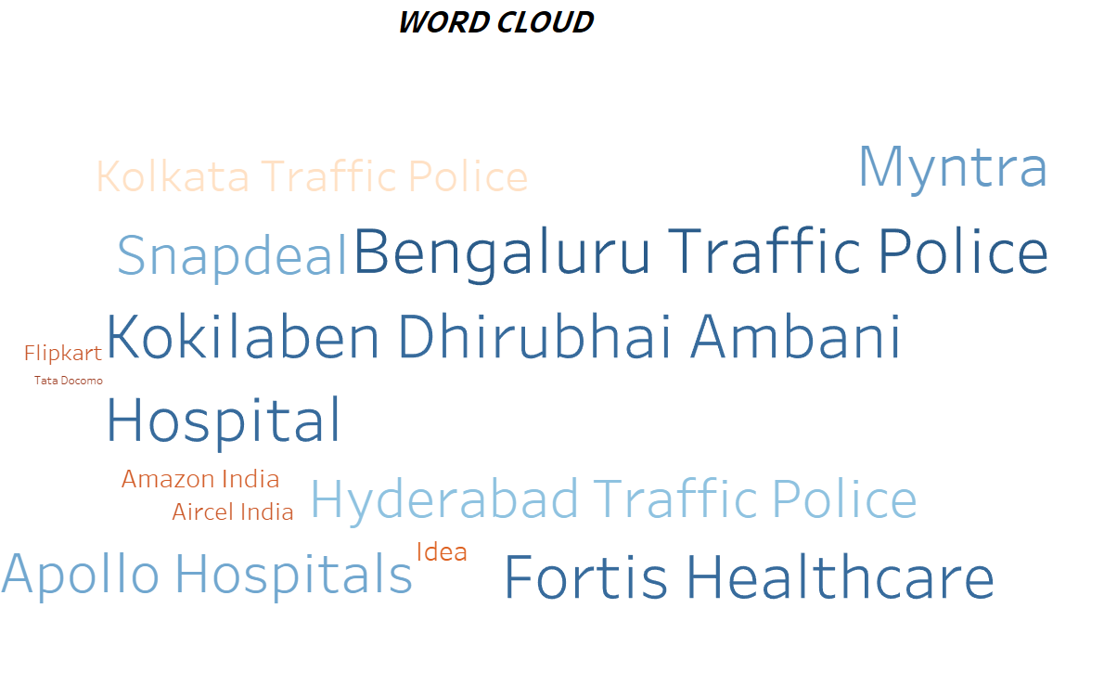
Word Cloud
Here is a pictorial representation of the names of different organizations about which people have posted on fb. From this, we can summarize that a lot of people are posting about traffic of Bengaluru and Hyderabad along with different famous medical centres around the country like Fortis and Apollo Hospitals. Along with that, you can see the popularity of various e-commerce websites such as Myntra, Snapdeal and Amazon which gives a clear indication of increase in online shopping and inclination of people towards it.

